Slide 1

Software Engineering
Doctors Appointment & Medicine
Members:
Aseya Khanom[17-35394-3]
Bushra Amana[18-36568-1]
Shafin Talukder Nill[18-36588-1]
Arshad Hassan Aywon[18-36601-1]

Slide 2

Introduction
Online Doctor Appointment
*See Doctors List and visiting times
*Confirm Doctor serial
* Feedback
Why this proposal:
Saving of time, money and energy.
Make the medicine shipping more comfortable.

Slide 3
Introduction
Online Medicine
*Local
*Foreign
#Order Unavailable Medicines
Why this proposal:
To save energy and time.
Take the appointment system at a high stage.

Slide 4
Some website for online medicine
ONLINE PHARMACY INDIA
TRUST PHARMACY
DRUGS.com
NHS PHARMACY UK
Why you use DAM for online medicine purpose?

Slide 5
Some website for online appointment in Bangladesh
E-sastho seba
Doctorsbd.com
FEELWELL
Square Hospital Limited
Popular hospital Limited
Why you use DAM for online doctor appointment?

Slide 6
System Analysis and design
Stakeholder: A stakeholder is either an individual, group or organization who is impacted by the outcome of the project. They have an interest in the success of the project and have a positive or negative influence on it.
Stakeholders for our project:
Doctors.
Hospitals.
Volunteers.

Slide 7
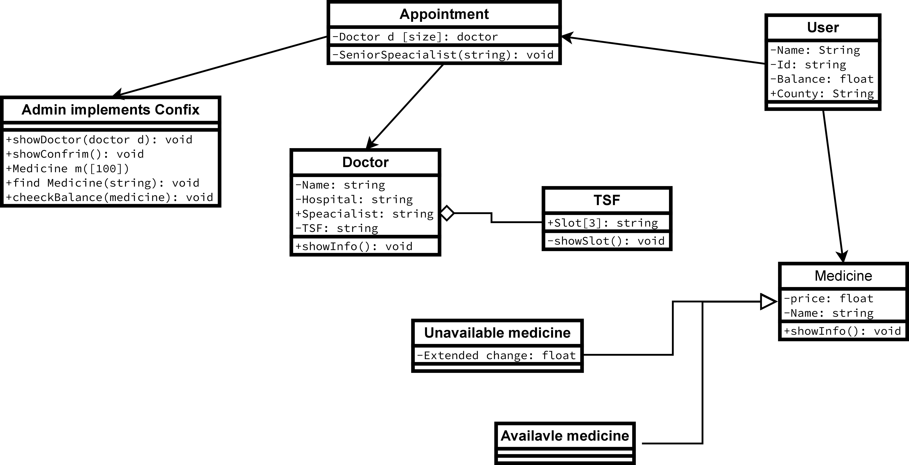
Class Diagram

Slide 8
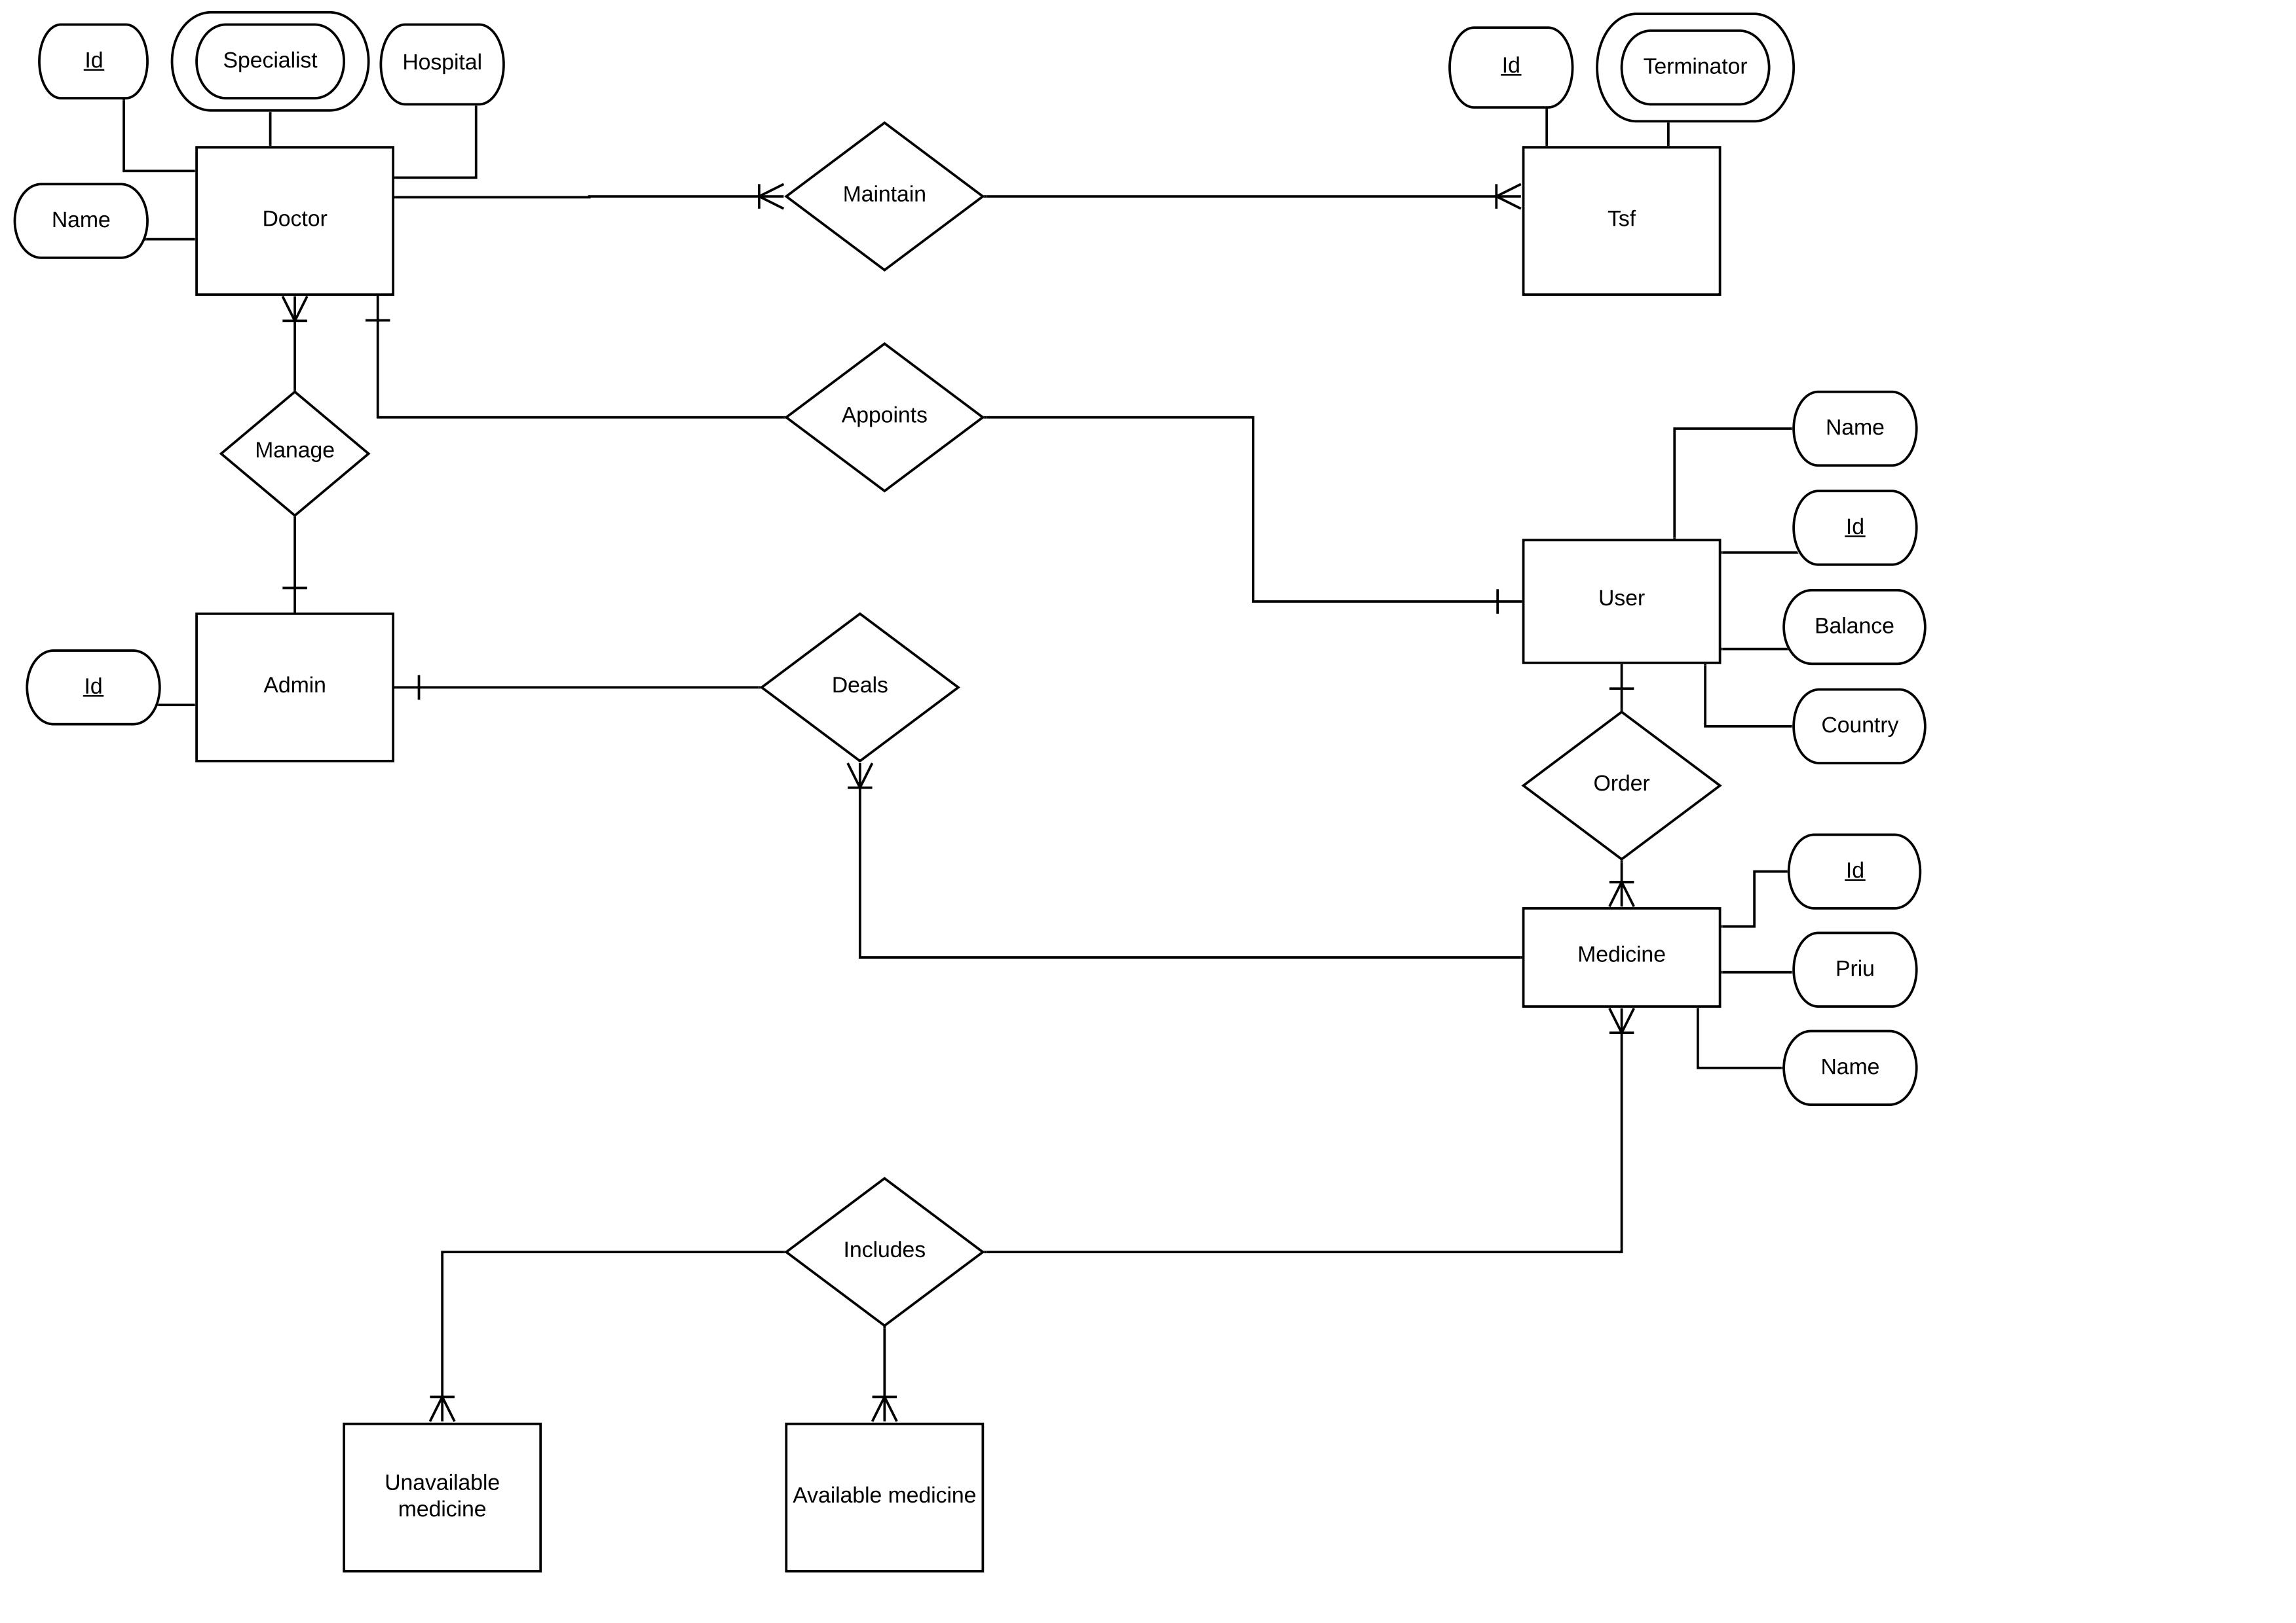
ER Diagram

Slide 9


Slide 10


Slide 11


